Slide 1
Motherboard
Presented by
Group 6
FYCM

Slide 2
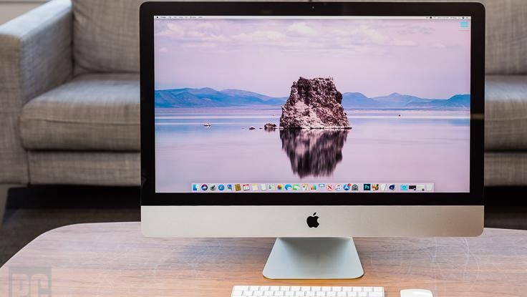
Introduction
Computer
A computer is a device that accepts information (in the form of digitalized data) and manipulates it for some result based on a program, software, or sequence of instructions on how the data is to be processed. ... Today's computers have both kinds of programming.

Slide 3
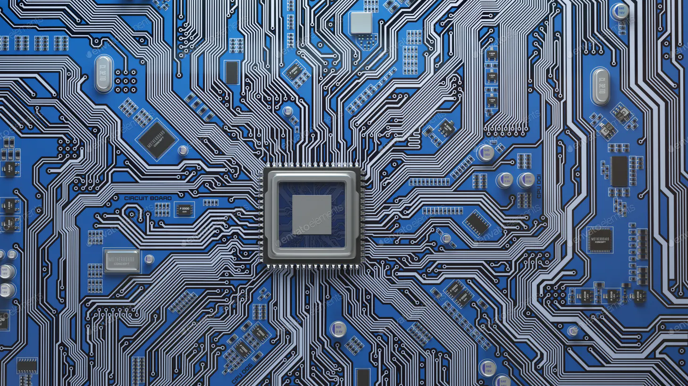
2. Motherboard
A motherboard is one of the most essential parts of a computer system. It holds together many of the crucial components of a computer, including the central processing unit (CPU), memory and connectors for input and output devices.

Slide 4
Types
AT Motherboard
ATX Motherboard
Micro-ATX Motherboard
Mini ITX Motherboard
E-ATX Motherboard

Slide 5
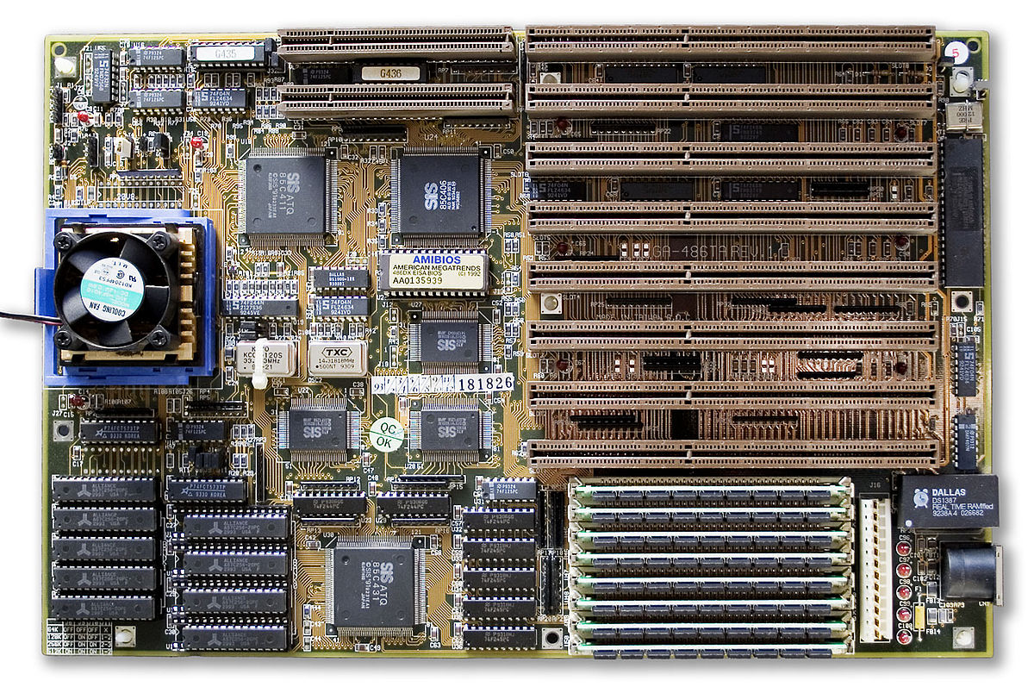
AT Motherboard
A motherboard that follows the same design and 12x13" form factor that was in the original IBM PC/AT. It was superseded by the Baby AT.

Slide 6
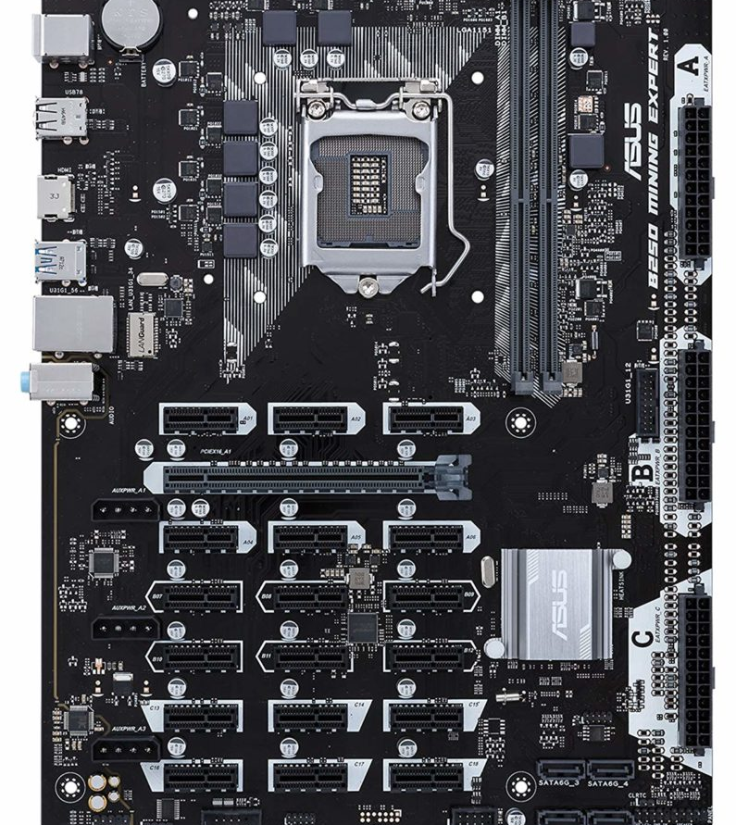
ATX Motherboard
(Advanced Technology EXtended motherboard) The PC motherboard that superseded the Baby AT design. The ATX layout rotated the CPU and memory 90 degrees, allowing full-length expansions to be plugged into all sockets. Dimensions of a full-size ATX board are 12 × 9.6 in (305 × 244 mm)

Slide 7
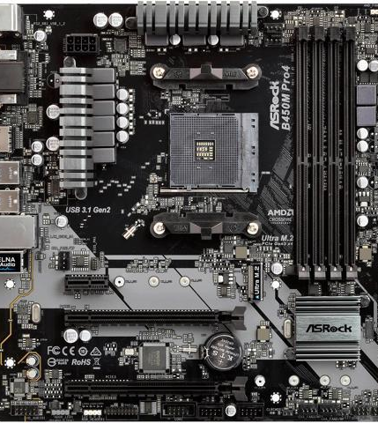
Micro- ATX motherboard
Micro-ATX is a standard for motherboards that was introduced in December 1997. The maximum size of a Micro-ATX motherboard is 9.6 × 9.6 in (244 × 244 mm). The standard ATX size is 25% longer, at 12 × 9.6 in (305 × 244 mm).

Slide 8
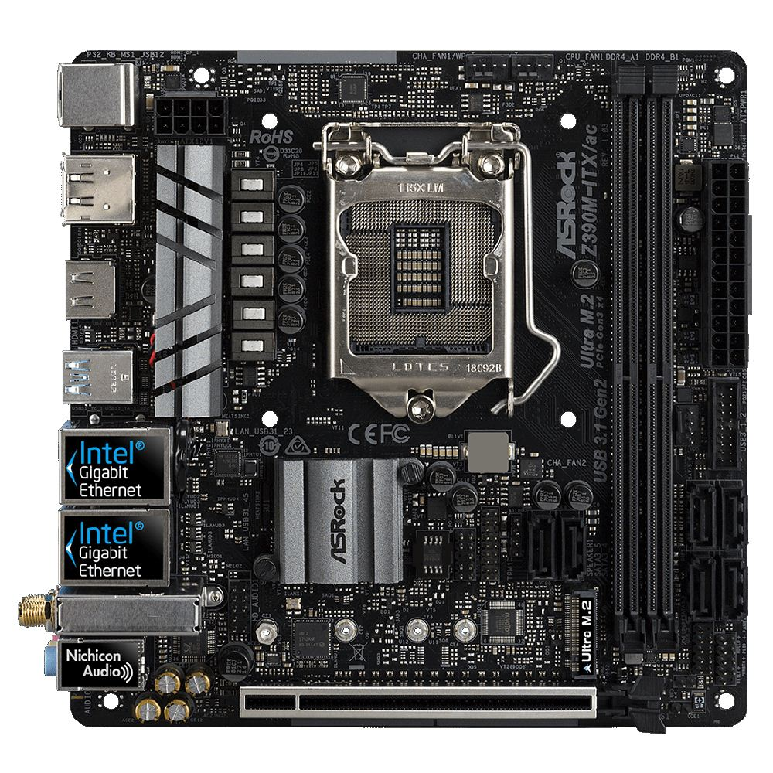
Mini-ITX Motherboard
Mini-ITX is a 17 × 17 cm (6.7 × 6.7 in) motherboard, developed by VIA Technologies in 2001. They are commonly used in small-configured computer systems. The design provides one expansion slot.

Slide 9
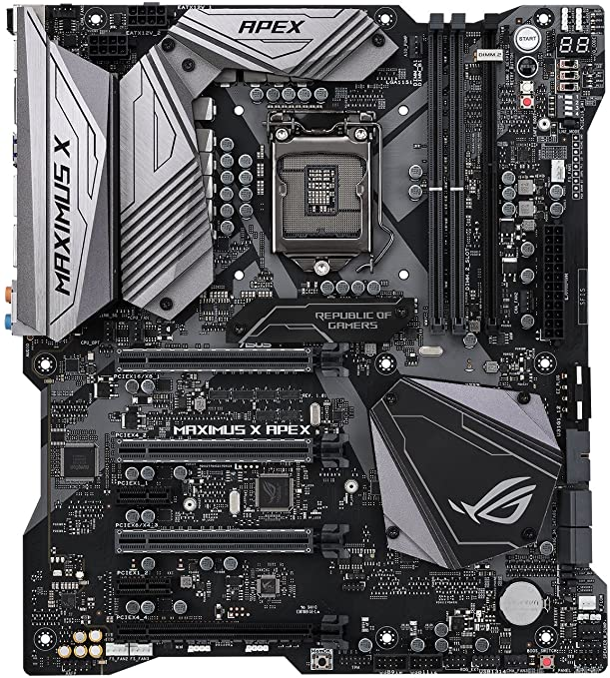
E-ATX Motherboard
(Extended ATX) is an ATX motherboard with an extended length of 13" instead of 9.6“.

Slide 10
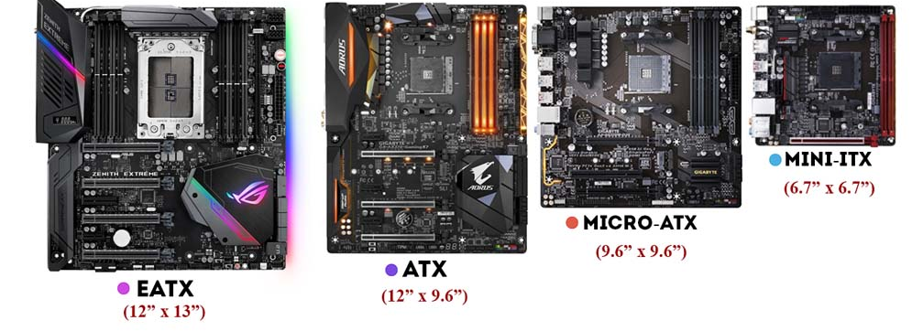
Overview

Slide 11
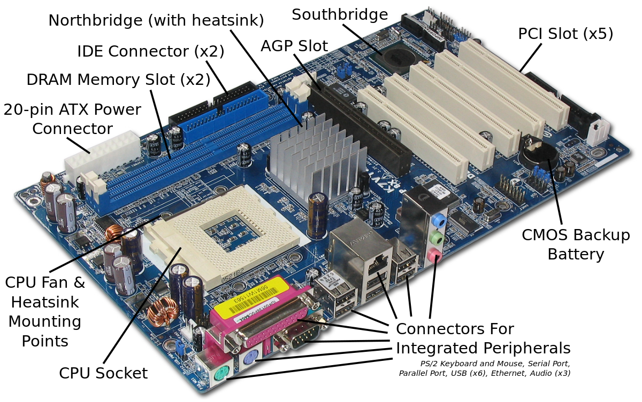
Components of Motherboard

Slide 12
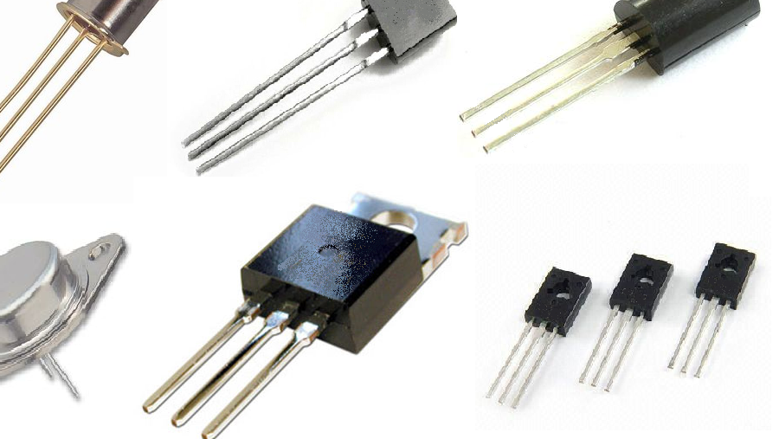
Active Components
An active component is a device that has an analog electronic filter with the ability to amplify a signal or produce a power gain. There are two types of active components: electron tubes and semiconductors or solid-state devices.

Slide 13
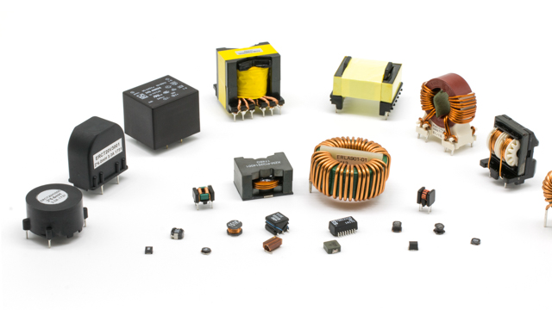
Passive Component
Passive components include two-terminal components such as resistors, capacitors, inductors, and transformers.
Electromechanical components can carry out electrical operations by using moving parts or by using electrical connections.

Slide 14
Top Motherboard Manufacturer’s
ASUS
GIGABYTE
MSI

Slide 15
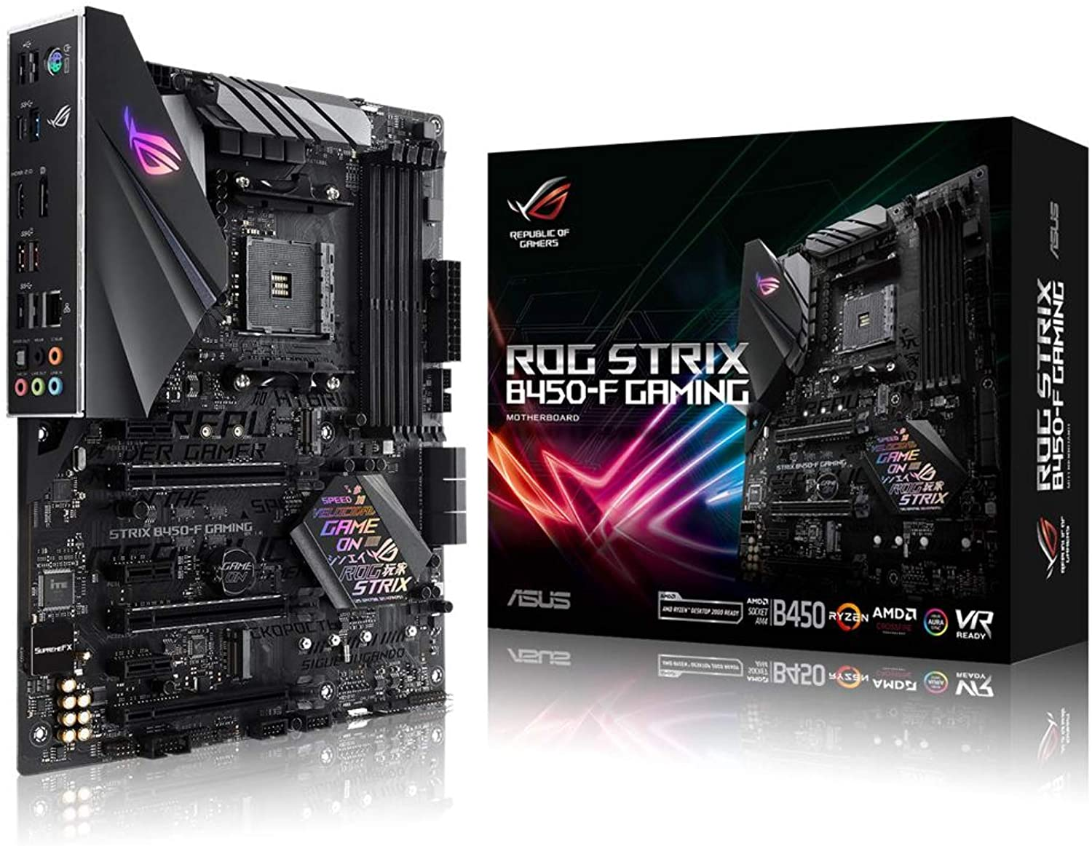
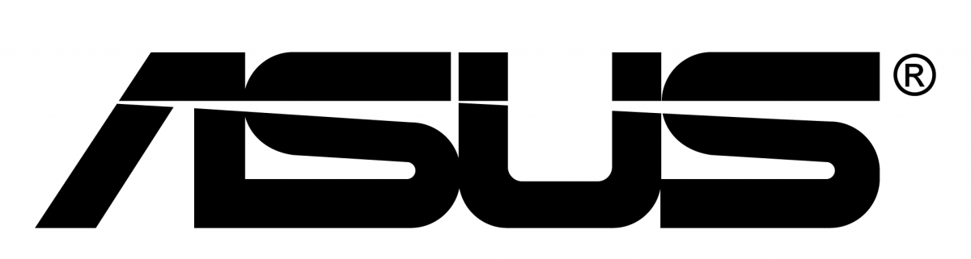
ASUS
AsusTek Computer Inc. is a Taiwan-based multinational computer and phone hardware and electronics company headquartered in Beitou District, Taipei, Taiwan.

Slide 16
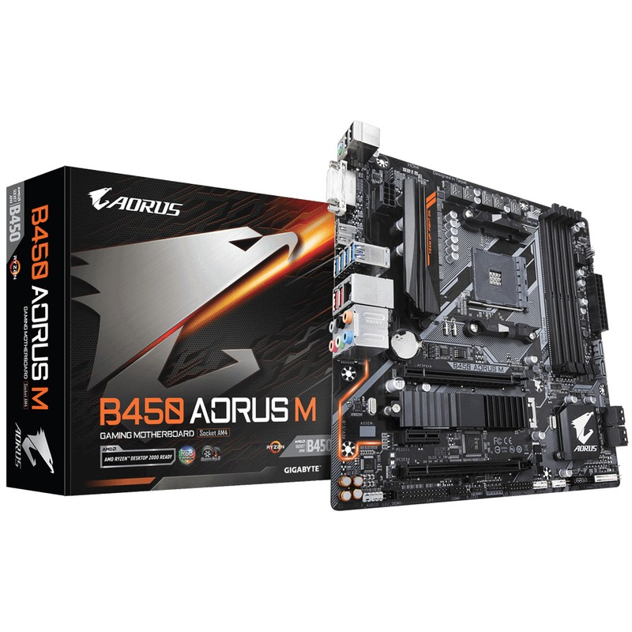

GIGABYTE
Gigabyte Technology, is a Taiwanese manufacturer and distributor of computer hardware. Gigabyte's principal business is motherboards, with shipments of 4.8 million motherboards in 2015, while Asus shipped around 4.5 million motherboards in the same quarter.

Slide 17
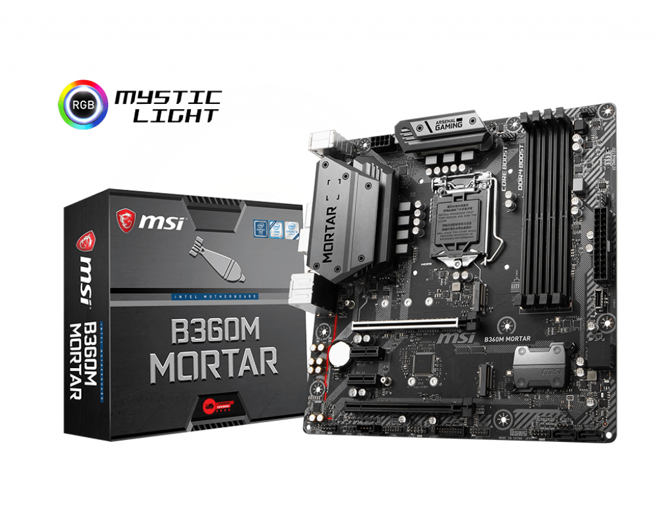
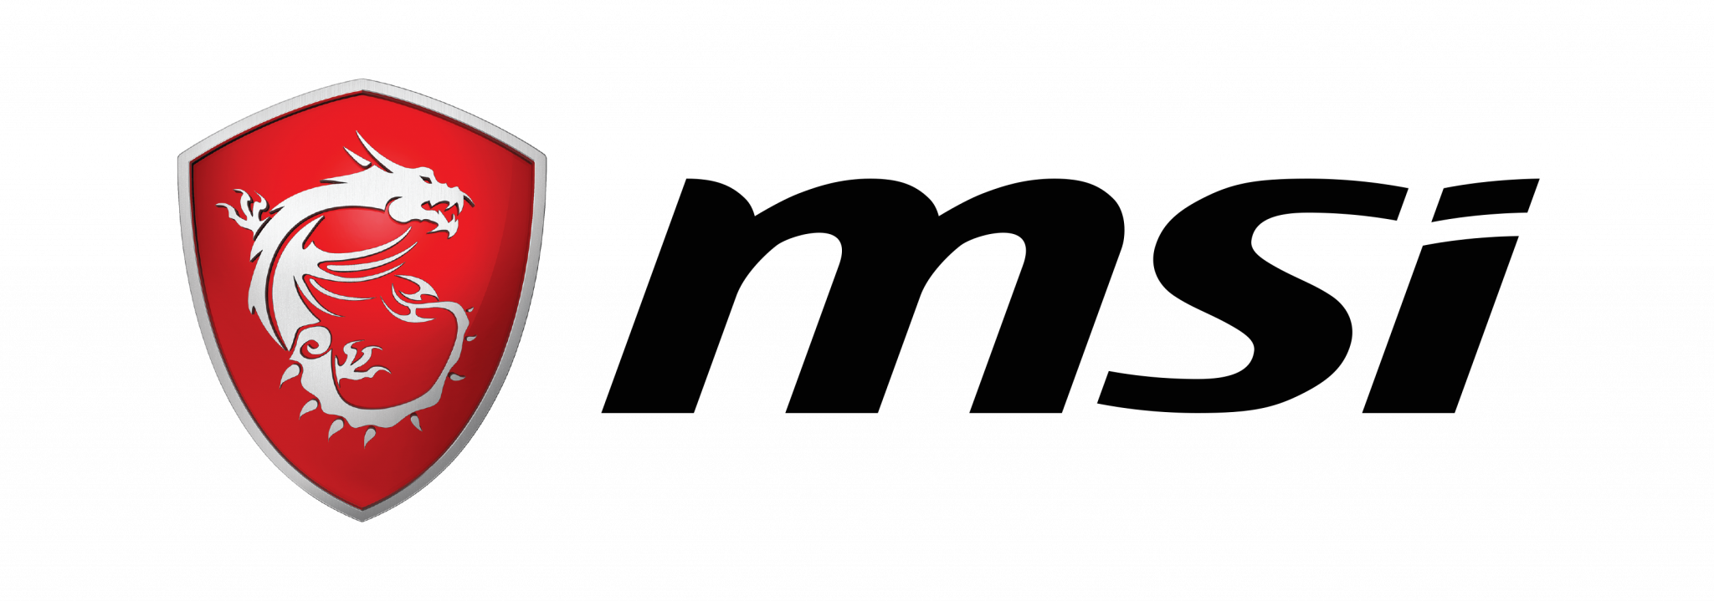
MSI
Micro-Star International Co., Ltd (MSI) is a Taiwanese multinational information technology corporation headquartered in New Taipei City, Taiwan. It designs, develops and provides computer hardware, related products and services, including laptops, desktops, motherboards, graphics cards.

Slide 18
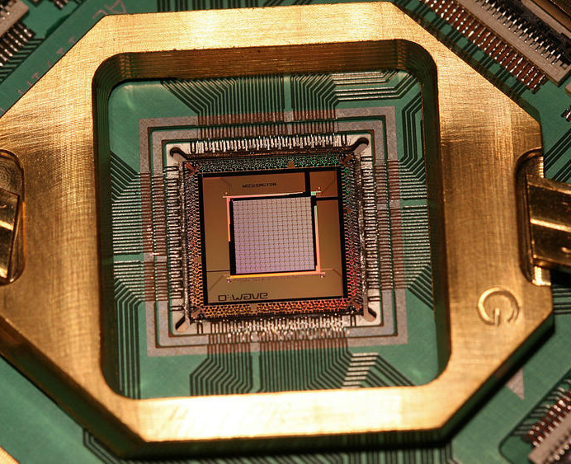
Thank You!

